Slide 1


Creating the responsive supply chain

Slide 2


Main Title Goes Here….
Product ‘push’ versus demand ‘pull’
The Japanese philosophy
The foundations of agility
A route-map to responsiveness
www.umt.edu.pk

Slide 3
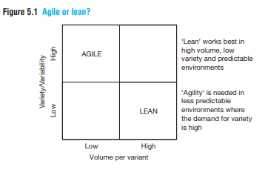
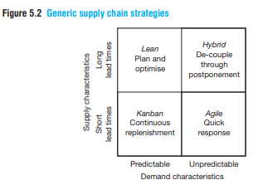
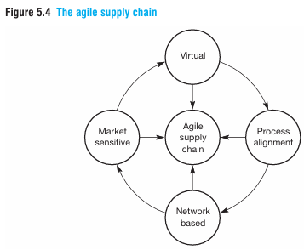
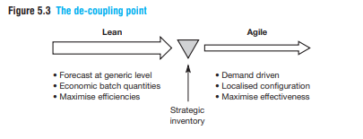

Slide 4
Product ‘push’ versus demand ‘pull’
Push system makes products based on forecasts (guessing demand) to have stock ready, like stocking groceries, while a Pull system makes products only when a real order comes in, like a custom-built computer, reducing waste but needing faster production.
Inventory acts as a buffer between stages
(factory → warehouse → RDC → customer).
Typical characteristics:
  Batch production
  High work-in-progress (WIP)
  Risk of overstock or obsolescence
Key weakness:
Forecast errors propagate upstream, leading to excess inventory and inefficient resource use.

Slide 5
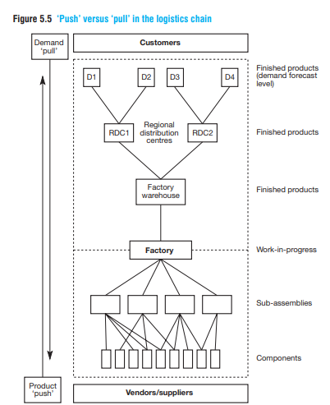
Pull System (Just-in-Time)
Activities are triggered by actual demand from downstream stages.
Demand at the customer end pulls products and components through the system.
Inventory is minimized and synchronized with demand.
Core JIT principle:
No activity should take place until there is a downstream requirement.
Strategic implication:
Pull systems improve responsiveness, reduce inventory costs, and expose inefficiencies.

Slide 6
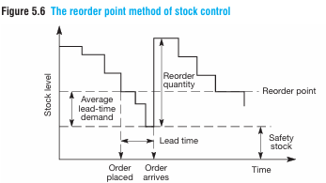
Reorder Point (ROP) Method of Stock Control Concept (Ref PPC)
Inventory is replenished when stock falls to a predetermined reorder point.
Key Elements
Reorder Point (ROP) = Average demand during lead time + Safety stock
Lead time: Time between placing and receiving an order
Order quantity: Often determined using EOQ
Strengths
Simple and widely used
Suitable for independent demand items
Limitations
Assumes stable demand and lead time
Performs poorly when demand is:
  Volatile
  Seasonal
  Lumpy (discrete large orders)

Slide 7
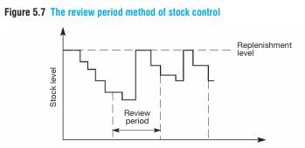
Review Period Method of Stock Control
Inventory is reviewed at fixed time intervals.
Order quantity varies to raise stock up to a target (replenishment) level.
Key Features
Review period is constant
Order size is variable
Common in retail and multi-item environments
Weakness
Inventory levels fluctuate widely
Risk of stockouts or excess stock between review periods

Slide 8
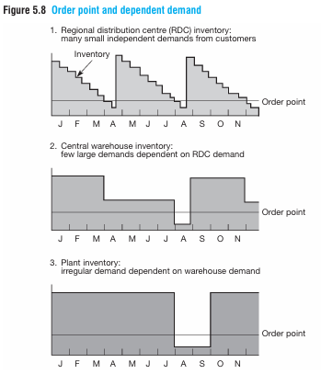
Order Point and Dependent Demand
How smooth demand downstream becomes lumpy upstream.
RDC inventory
  Faces many small, independent customer demands
  Appears relatively smooth
Central warehouse
  Demand depends on RDC reorder decisions
  Larger, less frequent orders
Plant
  Demand becomes irregular and highly variable
  Strong batching effect
Even when final customer demand is stable, the use of reorder points amplifies variability upstream.
Whilst independent demand may be forecast using traditional methods, dependent demand must be calculated, based upon the demand at the next level in the logistics chain.

Slide 9
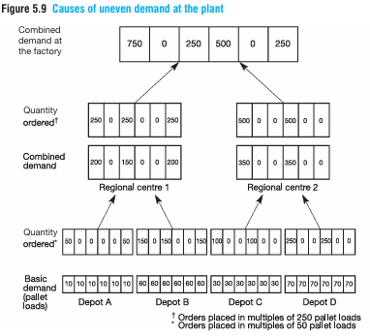
Causes of Uneven Demand at the Plant
Effect of demand aggregation and batching effects.
Mechanism
Depots place orders in fixed multiples (e.g., 25 or 50 pallet loads)
Regional centres aggregate depot orders
Factory sees:
  Large spikes
  Periods of zero demand
Result
Artificial demand variability
Poor capacity utilization
Increased inventory and scheduling inefficiencies
This phenomenon is closely related to the bullwhip effect. (Small changes in consumer demand cause progressively larger fluctuations in orders upstream)

Slide 10
Basis of Comparison | Independent Demand | Dependent Demand
Meaning | Demand not directly related to demand for any other item | Demand directly derived from demand for another item
Relationship with other items | Unrelated to other products or components | Dependent on demand for finished goods or parent items
Position in supply chain | Occurs at the final demand point | Occurs upstream (warehouse, factory, suppliers)
Source of demand | External customers or market | Internal requirements of the supply chain
Nature of demand | Random and uncertain | Deterministic once final demand is known
Planning approach | Forecasted | Calculated, not forecasted
Typical tools used | Time series forecasting, regression, qualitative methods | BOM, MRP, production schedules
Order pattern | Generally smooth (if market stable) | Often lumpy if poorly coordinated
Inventory implication | Higher safety stock required | Lower safety stock if properly planned
Examples | Retail customer demand, depot demand | Component demand, raw material demand

Slide 11
The Japanese philosophy
Inventory Hides the Problems
Japanese operations philosophy views inventory as waste.
High inventory hides inefficiencies instead of solving them.
Reducing inventory exposes operational problems.
Why Inventory is Dangerous
Masks demand variability
Hides supplier unreliability
Delays quality problem detection
Encourages inefficient processes

Slide 12
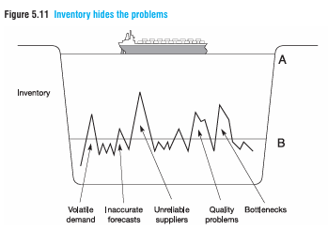
Element in Diagram | Represents in Business
Water level (Inventory) | Amount of inventory held
Ship | The organization / production system
Rocks below surface | Operational problems
High water level (A) | Excess inventory hiding problems
Low water level (B) | Reduced inventory exposing problems

Slide 13
Kanban: The Tool to Lower the Water Level
What is Kanban?
A pull-based control system
Originated in Japanese assembly operations
Uses signals (originally cards) to authorize production or movement
Meaning of “Kanban”
Japanese word for a signal card that authorizes replenishment
Kanban Advantages
Production triggered by actual demand
Only required quantity produced
Low inventory levels
Problems exposed quickly

Slide 14
Kanban as a Pull System
Push System | Pull (Kanban) System
Production based on forecasts | Production based on actual demand
Inventory pushed downstream | Inventory pulled by demand
Problems hidden by buffers | Problems exposed quickly
How Kanban Works
  Final demand triggers production
  Assembly line pulls only what it needs
  Each workstation pulls from the previous one
  No production without a Kanban signal

Slide 15
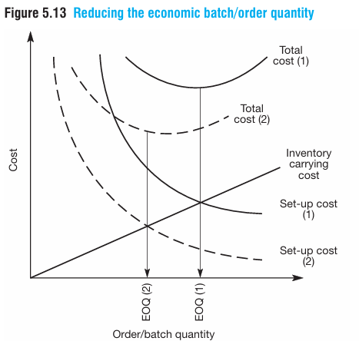
Reducing Kanban Quantity = Revealing Problems
Action | Result
Reduce Kanban quantity | Lower inventory
Lower inventory | Bottlenecks appear
Bottleneck exposed | Management intervention
Bottleneck removed | Further Kanban reduction

Slide 16
Numerical Example – Push System
Forecast demand = 1,200 units/month
Actual demand = 1,000 units/month
Production = 1,200 units
Ending inventory = 200 units/month
Inventory builds up and hides demand error

Slide 17
Numerical Example – Pull System
Actual customer demand = 1,000 units/month
Production = 1,000 units
Ending inventory = 0
Any delay or defect immediately stops production
Problems become visible

Slide 18
Kanban Reduction Logic
Reduce Kanban quantity
Inventory decreases
Bottleneck appears
Fix bottleneck
Reduce Kanban again

Slide 19
Economic Batch Quantity of 1
Japanese ideal
Achieved by reducing setup and ordering costs
Smaller batches become economical
Supports Just-in-Time (JIT)

